Slide 1






Partnership Opportunities with Thomson Reuters

Slide 2


Destinations:
Why ONESOURCE
Why Thomson Reuters
Partnering opportunities
The indirect tax
opportunity
Introductions
Next steps
Notes:
Agenda slide

Slide 3
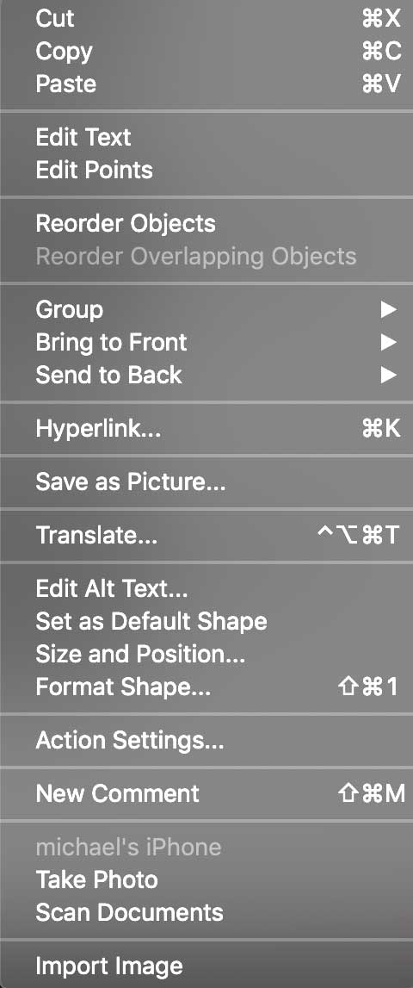

NAME
Title
NAME
Title
Our Team
NAME
Title

Slide 4

Thomson Reuters: Strengths and Highlights
Legal Professionals
$2.4B — 41% of Revenue
Corporates
$1.3B — 22% of Revenue
Tax & Accounting
Professionals
$0.8B — 14% of Revenue

Slide 5

Estimated $13 billion professional
content market segment
#1 position in the U.S. and Canada
~500,000 customers
Thomson Reuters: Strengths and Highlights
Attractive End Markets
Leadership Position
Focused on
Accelerating Growth

Slide 6

AI-enhanced products
Best-in-class products and services
~90% retention
78% recurring revenues
Thomson Reuters: Strengths and Highlights
Attractive End Markets
Leadership Position
Focused on
Accelerating Growth

Slide 7

Soaring
Demand for indirect tax solutions is at an all-time high—and growing every day
higher
Increasing complexity is driving a heightened need for tax automation:
7
4
%
  of companies plan to invest in indirect tax technology.¹
  The indirect tax global total addressable market (TAM) is $13 billion.²
  $6 billion
  Estimated TAM
  of the
  small/midmarket ¹

Slide 8

eed
Are you seeing increasing demands
within your customer base?
N
How many of your customers are
engaging in e-commerce?
Arriving
Are they operating in 20+ states or considering international expansion?
Is tax automation being discussed as part of an ERP install?

Slide 9

How are you addressing your clients’ needs today?
Are your customers happy?
Are you getting the support you need?
C
Would you consider an alternative?
ourse
Change of

Slide 10



How are you addressing your clients’ needs today?
Provides end-to-end indirect tax solutions for organizations of any size seeking a partner who can scale as their business evolves and complexity grows
3 PILLARS
  Confidence and Collaboration: The World’s Leading Tax and Trade Solution
  Breadth and Depth: The Most Comprehensive Global Content Coverage
  Efficiency and Insights: Modern Technology to Optimize Operations and Compliance

Slide 11

What a partnership with Thomson Reuters could mean for your customers
A Complete Tax Technology Suite
Global Content and Support
Outstanding
Customer Service
Priced to scale as corporations grow

Slide 12

What a partnership with Thomson Reuters could mean for you
Seamless customer experience
Incremental revenue opportunities
Near term simplicity with long term viability
Transparent and
consistent pricing

Slide 13

Ready to start your journey?
  MARKETING
  Joint marketing, promotion, and name association between you and Thomson Reuters.
  REFERRAL
  Financial incentives for sharing leads and collaborating to drive software sales and engagements.
  RESELLER
  Fully package our offerings with yours and create a seamless outcome for your customers.

Slide 14


Partnership Opportunities with Thomson Reuters

