Slide 1

Tax Professionals 2019 Roadshow
27 March, 2019

Slide 2

Tax Professionals 2019 Roadshow
Montreal, Canada
Notes:
Great to be with you today – we’re kicking off the first stop on the Tax Professionals 2019 Roadshow with you today!
Why are we here?
In addition to our regular cadence of all-hands calls and town halls (which I’ll tell you about later), the Tax Professionals leadership team is making an effort this spring to see as many of our Tax Professionals team as we can in-person.
Today, we’ll talk about our customers and the challenges they’re facing
Then I’ll share some of the amazing ways that our teams are responding to our customers’ needs, by covering:
YTD key stats from this tax season
Customer feedback
Front-line success stories that illustrate our New Ways of Working
Then we’ll close by sharing some of the initiatives underway across the organization to help you win in 2019.

Slide 3



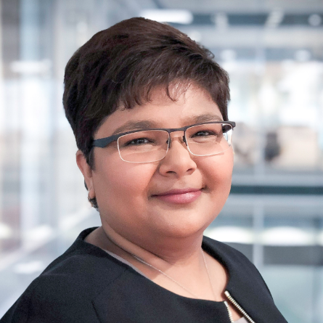






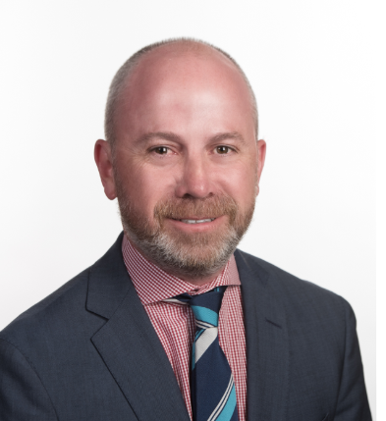



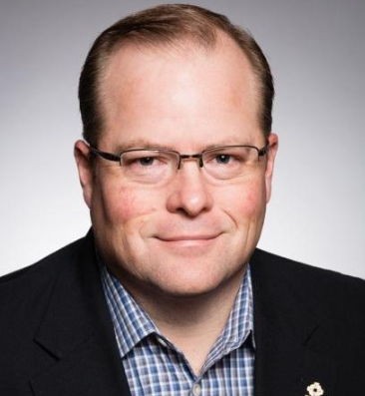
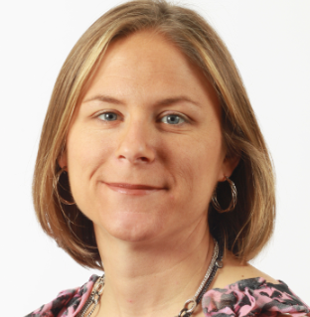


Tax Professionals Leadership Team & Guest ELT Members
Heather Walker
Emerging Markets
Keith Nichols
Small-Mid Firms
Keith James
Large Firms
Swati Garodia
Product
Joe Jackson
Government
Sejal Amin
Technology
Jenny Riggs
Customer Success
Michelle Scheer
Finance
Todd Sample
Strategy
Paul Brindle
Product
Hideo Esaka
Marketing
Bill Chase
HR
Laura Rojo-Eddy
Comms
Rob Beattie
Sales
Rachel Bryant
Marketing
Nancy Hawkins
Editorial
Brian Wright
Customer Success

Slide 4
Our customers…
Notes:
Let’s start with our customers….

Slide 5










Our customers
Top customers
Customer dynamics
Segments
Large Firms
(30+ professionals)
Offer breadth of premium accounting services to diverse client base
Need solutions that can deal with more complex customer scenarios
Need help innovating to keep up with the Big 4
Mid-Sized Firms
(4-29 professionals)
Dependent on software to do their tax, accounting, & audit work
As automation continues, looking to diversify their service offerings
Increasingly interested in the benefits of the cloud & other new technologies
Small Firms
(1-3 professionals)
Little time or resources to think strategically about firm growth
Majority of client base is consumers/individuals
Challenged with busy season compression
Government
Riverside Co.
Gwinnett Co.
Tarrant Co.
Government tax professionals who assess & collect property taxes
Customer need is to track land registration, ownership, & property value
Notes:
Who are our customers and what are the dynamics in each of their segments?...
Our large firm customers serve a diverse client base with a breadth of premium accounting services so they need solutions that deal with complex client scenarios
Our mid-sized firms depend on software for their tax, accounting and audit work and are looking to diversify their service offerings as compliance services are commoditized
Small firms of 1-3 professionals serve a client base of mainly consumers and individuals and have little time or resources to think strategically about firm growth
Our government customers are professionals who assess and collect property taxes

Slide 6
Key trends & addressable market segment
Key Trends &
Customer Implications
Global Addressable
Market Segment
Changing Regulatory Environment
Changing regulations, tax simplification initiatives, and digitization of tax filing
Est. $6B
Market
Segment
Advanced Technologies
Artificial Intelligence automating core compliance & audit work
Growing 4-5%
New Business Models
Customers shifting to more business advisory services work
Notes:
Our customers are facing massive regulatory, technological and existential challenges.
They have to continue evolving in order to thrive in their environment of constant change.
That’s where we come in… and in order to outpace current market growth, we have to be relentlessly focused on our customers.

Slide 7
Tax professionals – 2019 OKRs
 | Customer | Gro | Digital | Culture | Simplify
OBJECTIVES | Delight our customers with a superior experience and holistic propositions based on their needs | Accelerate customer-led growth through go-to-market levers (cross-sell, adding new customers, pricing) and new product launches | Drive exponential growth in our digital interactions with our customers | Operate as one team and culture that is empowered, engaged, diverse, and agile | Simplify our organization, product portfolio, and customer experience
KEY RESULTS | Move 150 customers to LOTUS Increase Net Promoter Score* Decrease Customer Effort Score* Reduce Mean Time to Recover from service incidents by 5% a quarter Improve customer service response and resolution time* Increase retention | Sell more to existing customers Generate recurring sales from new customers, adding 10,000 net new customers Launch our next generation of professional software solutions Offer an innovative new audit workflow solution Introduce the intelligent tax research solution through AI-powered Checkpoint | Conduct 35% of Small-Mid Firms sales and renewals digitally Build out and accelerate digital marketing* | Improve Organizational Health Index by 5% Improve talent retention Each ELT member to sponsor at least one gender or ethnically diverse high potential employee Cultivate new ways of working | Achieve additional margin expansion Serve 25% of customer support queries through digital self-service Execute on product sunset/platform migrations
Our Vision: To enable our customers to be trusted business advisors in a world of ongoing regulatory and technological change.
Think big. Make it simple. Move fast.
* Baseline metrics pending
Notes:
Our Tax Professionals 2019 OKRs are our roadmap – these are the objectives and key results that we’re driving towards. We’ll provide updates on our progress on these regularly.
Don’t forget to keep an eye on your personal goals to stay on track or to tweak them if necessary as priorities change.

Slide 8
How our teams are responding
Notes:
So how are our teams – including you – responding to our customers’ needs and challenges?

Slide 9
2019 Tax Season (as of 16 March)
​ | Technical Support​ | Customer Support​
Contacts Handled​ | ~221,740​ | ~41,500
Contact %​ - Phone - Digital (E-mail / Chat)​ | ​ ~80%​ ~20%​ | ​ ~72%​ ~26%​
 | Technical & Customer Support (Software and Content)
ASA (Avg. Speed to Answer)​ | 3:46​ (min: sec)​
​AHT (Avg. Handle Time) | ​10:21 (min: sec)
Notes:
We’re in the thick of tax season in the US so I’d like to share a snapshot of the volume the support team is managing, as of March 16…
It’s interesting to note that while we’re not yet seeing an overall increase in support volume over 2018, we are seeing an increase in call length, which we attribute to the complexity of issues related to the Tax Cuts & Jobs Act in the US.

Slide 10
Market Context
Progress Update: Tax Year
2018 Releases
The Tax Cuts and Jobs Act (TCJA) was the biggest change in the US tax law in 30 years, with significant changes at the Federal level and many states adopting various levels of the Federal approach.
As an example, in a typical year, we would update 15-30% of the 304 products within UltraTax. This year, 85% were updated.
Legislative changes, especially state and local, will likely run into Q2 2019.
Virtually all Tax Year 2018 individual products (Federal, State, & Local) have been released, with only a small number of fiscal year/late due dates to be delivered.
Overall customer feedback on Tax Year 2018 releases and product quality has been in line with previous seasons, although there have been challenges in specific areas that impact some firms more than others.

Slide 11
New Ways of Working
“My support experience with Gary Crosby was beyond exceptional — he kept me on the line until we had everything resolved, which was longer than we both expected!”
“Excellent and timely support from our rep, Susan Assadi.”
“Dave King has been very helpful. Especially as he has had to learn our quirky ways. I am now looking into WestLaw for our attorneys and I found Mark K Martin VERY helpful with my request for information to present to the attorneys.”
“Demetra Copeland was able to help with a CS Engagement issue I have had for a long, long, long time. She kept plugging away, and she finally solved it. Demetra rocks!”
“Jacques L’Italien is very helpful and patient with trying to solve my problems. Excellent support staff.”
“Heather Waite and April Schweitzer are always willing to help. Never snappy even when sick. They make this company!! Heather and April rock!”
“Rose Perkins and Lindsey Siroonian have been incredibly helpful.”
Notes:
But it’s not just what our teams are doing that is impressive, it’s HOW you’re doing it that will be the they key to meeting our aggressive growth goals in 2019.
Many of you are delighting our customers by putting our New Ways of Working into action, by Thinking Big, Moving Fast and Making it Simple…
You may have seen the Customer Experience Hall of Fame blogs on the Hub for January & February…
Here are a few of the great comments our customers shared about their TR support teams…
- “My support experience with Gary Crosby was beyond exceptional - he kept me on the line until we had everything resolved, which was longer than we both expected!”
- "Demetra Copeland was able to help with a CS Engagement issue I have had for a long, long, long time. She kept plugging away, and she finally solved it. Demetra rocks!"
- “Heather Waite and April Schweitzer are always willing to help. Never snappy even when sick. They make this company!! Heather and April rock!”

Slide 12

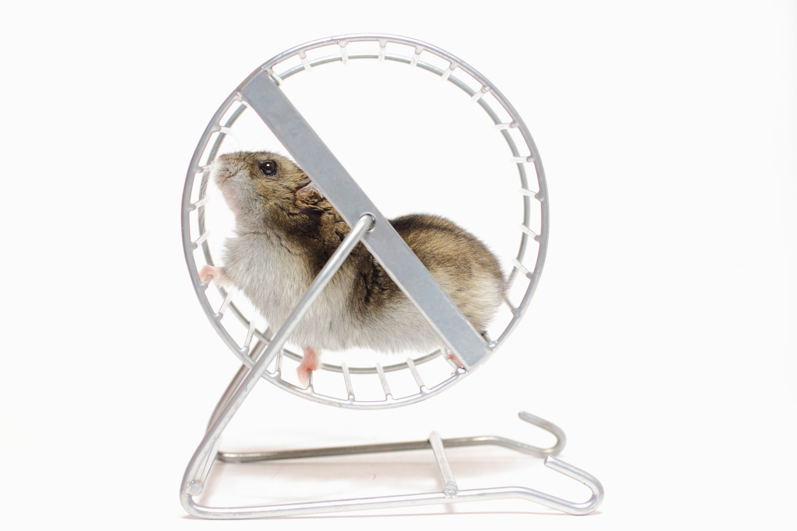
New Ways of Working
Notes:
In every area of the business, our teams are collaborating, taking accountability and being empowered to solve problems when they see them…
Here are a few examples of our teams exemplifying our new ways of working…

Slide 13
New Ways of Working
Customer confusion over a new piece of tax law related to TCJA
Collaboration between development and Customer Success teams
Simplified product design for customers and a dramatic drop in call length on related topics
Notes:
When our customers expressed confusion over a new piece of tax law related to TCJA, our development and Customer Success teams came together to work on a solution.
The Customer Success team brought the voice of the customer to the conversation, explaining to the development team what was causing our customers so much confusion. This collaboration led to the development of a simplified product design that resulted in a dramatic drop in call length on related topics.

Slide 14
New Ways of Working
Customer confusion over a new piece of tax law related to TCJA
Collaboration between development and Customer Success teams
Simplified product design for customers and a dramatic drop in call length on related topics
Customer dissatisfaction with product & threatening to terminate
Implemented training plan to address customer concerns
Happy customer, improved onboarding for all new customers
Notes:
In our next case, the Digita Accounts Production Advanced (DAPA) team had a dissatisfied customer that was threatening to terminate. Their account support specialist implemented a training plan for the firm and held regular follow-ups with their team. The additional training resulted in a dramatic drop in support cases for the firm as well as an improved onboarding process for all new customers.

Slide 15
New Ways of Working
Customer confusion over a new piece of tax law related to TCJA
Collaboration between development and Customer Success teams
Simplified product design for customers and a dramatic drop in call length on related topics
Customer dissatisfaction with product & threatening to terminate
Implemented training plan to address customer concerns
Happy customer, improved onboarding for all new customers
Customer perception during UltraTax CS transition
Set up communication plan with customer to keep her informed
Satisfied customer signed up for Partner Summit & training for staff
Notes:
In our last story, one of our customers was feeling in the dark about her firm’s transition to UltraTax CS, despite multiple attempts by our onboarding team to reach her.
Our onboarding specialist set up a communication plan to change her perception that included bi-weekly check-in calls and tie-ins with their sales rep.
The process rebuilt the relationship and resulted in the customer signing up for a Partner Summit and additional training for her staff.

Slide 16
Winning in 2019
Notes:
These stories are a great reminder that to win in 2019, we need to:
keep relentless focus on our customers
Be empowered to solve challenges with our new ways of working
Let our OKRs be our guide
That said, we know there are still challenges in our new organization.
So… what can you expect from the organization to help you succeed in 2019?
Teams across TR are planning and implementing initiatives to set you up for success for the rest of the year. I’m going to share a few of those with you today…
Let’s start with HR…

Slide 17


OHI Survey
Notes:
First of all, thank you for taking the OHI survey! Your feedback is very important to us as we work to build the culture we want within Thomson Reuters and Tax Professionals.
While this survey was only meant to capture a snapshot in time, it’s designed to help us understand where we can improve as an organization and as a team.
We heard three key takeaways from your feedback:

Slide 18

OHI Survey: Takeaways
Talent Development & Coaching
You’ve asked for:
Development opportunities and defined career paths
Notes:
In the area of Talent Development / Coaching: you have asked for more development opportunities and better defined career paths

Slide 19

OHI Survey: Takeaways
Talent Development & Coaching
Leadership
You’ve asked for:
Development opportunities and defined career paths
You need more:
Clarity & accountability; meaningful work
Notes:
In the area of Leadership: you need more clarity and accountability from us and help with making your work more meaningful

Slide 20

OHI Survey: Takeaways
Talent Development & Coaching
Leadership
Creative & Entrepreneurial Environment
You’ve asked for:
Development opportunities and defined career paths
You need more:
Clarity & accountability; meaningful work
You want more:
Protection from day-to-day & compounding priorities
Notes:
Finally, in the area of creative and entrepreneurial environment, you want more protection from the day-to-day and compounding priorities
We hear you, and in the spirit of agility, we’re immediately activating a team of representatives from the Tax Professionals team to develop ideas and implement initiatives to address your needs and move us forward in these areas.
You’ll hear more about these initiatives in the coming weeks; let your manager know if you want to get involved!

Slide 21

Product Highlights
Notes:
Now let’s take a look at our product highlights for the year…

Slide 22

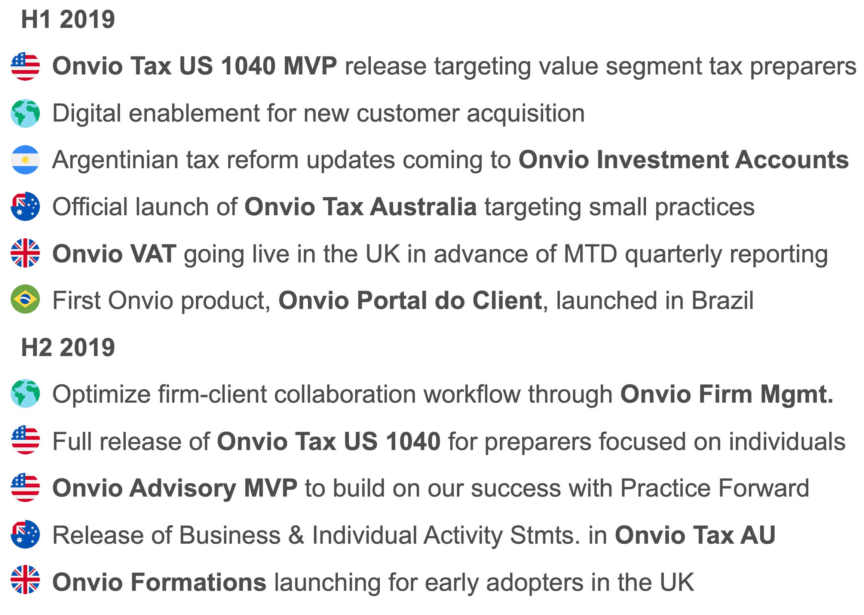






ONVIOTM: Thomson Reuters’ Global Platform for Tax Professionals
H1 2019
Onvio Tax US 1040 MVP release targeting value segment tax preparers
Digital enablement for new customer acquisition
Argentinian tax reform updates coming to Onvio Investment Accounts
Official launch of Onvio Tax Australia targeting small practices
Onvio VAT going live in the UK in advance of MTD quarterly reporting
First Onvio product, Onvio Portal do Client, launched in Brazil
H2 2019
Optimize firm-client collaboration workflow through Onvio Firm Mgmt.
Full release of Onvio Tax US 1040 for preparers focused on individuals
Onvio Advisory MVP to build on our success with Practice Forward
Release of Business & Individual Activity Stmts. in Onvio Tax AU
Onvio Formations launching for early adopters in the UK
H1 2019
H2 2019
Notes:
Onvio represents the future of our Tax Professionals business around the world.
This diagram represents a selection of some of the more significant new releases planned for Onvio throughout the world in 2019:
Onvio Tax will see its first release in the US, both as a focused MVP in the first half of the year and as a full release in the latter half
Onvio Tax will follow a similar release path in Australia throughout the course of the year, as well
In February, we launched our first Onvio application in Brazil, the Onvio Portal do Client
Staying ahead of compliance requirements,
Onvio Investment Accounts will receive updates in the first half as a result of recent Tax Reform in Argentina, and
Onvio VAT will see its first release in the UK in advance of the first VAT quarterly reporting deadline under the UK Government’s Making Tax Digital initiative
We will also be treading new ground with the release of an altogether new product, Onvio Advisory, as an MVP this Summer to complement our already successful Practice Forward consulting offering in the U.S.
We continue to work globally to digitally enable Onvio as part of our new customer acquisition strategy, and likewise we are optimizing the firm/client collaboration workflow in Onvio Firm Management, which will benefit Onvio users around the world

Slide 23






“The mobile ability of Onvio is huge. When we’re traveling, we can access whatever our clients need on the spot, wherever we are.”
ONVIO: What Our Customers Say
“[Onvio] is going to make your firm more efficient. Even in the first year it made my firm efficient enough that I could take additional time off work.”
H1 2019
“It’s good to see there has been much progress with Onvio development. The speed is great, better than FileCabinet CS.”
H2 2019
“[Compared to Digita FileCabinet] it is far more user friendly for both us and our clients. Having it all in one place is great.”
“I have never used organizers in my practice because I didn’t like asking clients to fill in those awful sheets. This system is engaging and driven by the documents. Well done!”
Notes:
Read a selection of one or more quotes, e.g. “A customer in ____ told us ____”
Consistently, around the world, our customers are discovering the way that Onvio can move their accounting firms forward – and it’s interesting to see the themes emerging across their feedback:
Whether it’s an accountant in the UK, or CPAs in Ohio and New York, there’s a consistent theme emerging around how Onvio empowers accountants to collaborate more effectively with clients.
It’s also great to see customers recognizing one of our overarching themes in developing Onvio: simplicity of use, a theme which all of these quotes touch on in some way.
It’s now on us to work together to continue collecting and acting on customer feedback – building up a reference base in every jurisdiction where Onvio is sold will be critical to our efforts to accelerate new Onvio sales, both this year and in years to come.

Slide 24


Transform Audit Workflow With Data Analytics
Planning
Gather Client Info
Risk Analysis
Audit Plan
Execution
Conduct Engagement including Data Extraction & Analytics
Prepare Financial Stmts.
Report Results
Prepare Audit Documents
Document/Data Analysis
ADVANCEFLOW
CHECKPOINT ENGAGETM
THOMSON REUTERS AUDIT INTELLIGENCE powered by INFLO
DATA EXTRACTION
DATA ANALYTICS
AI-powered Checkpoint research
DATA VISUALIZATION
& BENCHMARKING
24
Tax Professionals 2019 Roadshow
Notes:
The Audit profession will transform the way audit services are performed and delivered. Our customers can rely on us to take them into this new world of “continuous audit”. With the addition of Audit Intelligence powered by Inflo to our suite,
data extraction capabilities which cover 100% of client accounting systems.
To test entire populations of data and better identify high-risk items – enhancing the quality of their audits and avoid risking their reputation.
they can not only perform the audit a lot more efficiently, but can also provide their customers with a much better service.

Slide 25


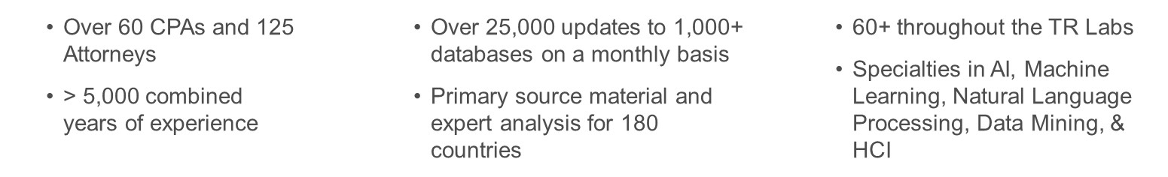
New CheckpointTM: The Intelligent Tax Research Solution
AI-powered Checkpoint research
Tax Editors
Data
Research Scientists
98% of customers interviewed rated the new Checkpoint experience a 4 or a 5 (out of a possible 5)
“This will cut down time spent searching, it will make it easier for newcomers to learn the system, and it is easier on the eyes.”
“If it’s…easier to find things, then I can delegate more work out to my staff and they'll be more adept at doing research. If the AI really works [like this], that's a homerun.”
25
Tax Professionals 2019 Roadshow
Notes:
When you look at our markets and the other vendors, we are in a unique position to disrupt tax research as we know it today.
We are the only company who has
Deep domain expertise in the field of tax law and the practice of tax research,
Huge volumes of data at our disposal, and
A large group of highly qualified data scientists deeply familiar with AI and related technology.
As a result, we are gearing up to change the nature of tax research as we know it with a major upcoming Checkpoint release which incorporates AI capabilities into the research and discovery process.
Although we can’t share a lot of detail at this time as we want to catch our competitors by surprise as we take the market by storm, but if the success of Westlaw Edge is any indication, we anticipate that this release will have a very significant impact on the Checkpoint product line and brand.

Slide 26

What else is coming in 2019?
AI-powered Checkpoint research
Notes:
So what else is coming in 2019?
Raise your hand if you’re heard of project LOTUS…
Now raise your hand if you know exactly what it is…

Slide 27

LOTUS is TR’s transformative initiative to reimagine the entire Customer Experience Journey, from generating a lead through to providing customer support.
Sales Experience
Simplification
Customer Experience
Enable cross sell and upsell
Reduce administrative burden
Create an easier ordering process
Use cleaner and fewer accounts and contacts
Improve our customer experience
Set our digital foundation
Be easier to do business with
Easier ordering and buying process
Fewer exceptions and streamlined processes
Notes:
To put it simply: Project LOTUS is an initiative meant to reimagine the entire Customer Experience Journey at TR, from generating a lead through to providing customer support.
LOTUS rollouts for Tax Professionals will be phased over a series of months, beginning in August 2019.
Keep an eye on the Tax Professionals page on the Hub for more details as the roll-out approaches.

Slide 28

Customer Events
Digita SYNERGY – 22-23 May
Partner Summit – April-August
Government SYNERGY – 22-26 September
US Tax Professionals SYNERGY – 6-9 November
Notes:
We’ll also be connecting with customers on a grand scale during numerous events this year, including:
Digita SYNERGY in May
Partner Summit, with events from April through August;
Government SYNERGY in September
US SYNERGY in November, as well as other events across the globe.

Slide 29
Communications Calendar 2019
 | MAR | APR | MAY | JUN | JUL | AUG | SEP | OCT | NOV | DEC
EVENT
Bi-Monthly Town Halls & All-Hands Calls |  | April 25 |  | June 20 |  | Aug. 13 |  | Oct. 17 |  | Dec. 5
Quarterly Managers Calls | March 29 |  | May 30 (TBC) |  |  | Aug. 8 (TBC) |  |  | Nov. 21 (TBC)
Notes:
You can expect to hear from me and the rest of the Tax Professionals leadership team on a regular basis to keep you up-to-date on our progress on the initiatives we shared with you today.
Here’s a look at our schedule of bi-monthly town halls/all hands meetings and tentative quarterly managers calls for the rest of the year.
Until we meet again, remember to:
keep relentless focus on our customers
Own it! Be empowered to solve challenges with our new ways of working
Let your OKRs be your guide
For now, I’d like to leave you with one more customer voice…

Slide 30


Customer Voice
!
REPLACE WITH REAL LINK AND VISUAL WHEN AVAILABLE
Hear it from an accountant: Lucy reveals how Mazuma has grown from a handful of clients to thousands across the UK.

Slide 31

Questions?

Slide 32

Tax Professionals 2019 Roadshow
Buenos Aires, Argentina
Notes:
Great to be with you today – we’re kicking off the first stop on the Tax Professionals 2019 Roadshow with you today!
Why are we here?
In addition to our regular cadence of all-hands calls and town halls (which I’ll tell you about later), the Tax Professionals leadership team is making an effort this spring to see as many of our Tax Professionals team as we can in-person.
Today, we’ll talk about our customers and the challenges they’re facing
Then I’ll share some of the amazing ways that our teams are responding to our customers’ needs, by covering:
YTD key stats from this tax season
Customer feedback
Front-line success stories that illustrate our New Ways of Working
Then we’ll close by sharing some of the initiatives underway across the organization to help you win in 2019.

Slide 33

Tax Professionals 2019 Roadshow
Dallas, Texas
Notes:
Great to be with you today – we’re kicking off the first stop on the Tax Professionals 2019 Roadshow with you today!
Why are we here?
In addition to our regular cadence of all-hands calls and town halls (which I’ll tell you about later), the Tax Professionals leadership team is making an effort this spring to see as many of our Tax Professionals team as we can in-person.
Today, we’ll talk about our customers and the challenges they’re facing
Then I’ll share some of the amazing ways that our teams are responding to our customers’ needs, by covering:
YTD key stats from this tax season
Customer feedback
Front-line success stories that illustrate our New Ways of Working
Then we’ll close by sharing some of the initiatives underway across the organization to help you win in 2019.

Slide 34

Tax Professionals 2019 Roadshow
Ann Arbor, Michigan
Notes:
Great to be with you today – we’re kicking off the first stop on the Tax Professionals 2019 Roadshow with you today!
Why are we here?
In addition to our regular cadence of all-hands calls and town halls (which I’ll tell you about later), the Tax Professionals leadership team is making an effort this spring to see as many of our Tax Professionals team as we can in-person.
Today, we’ll talk about our customers and the challenges they’re facing
Then I’ll share some of the amazing ways that our teams are responding to our customers’ needs, by covering:
YTD key stats from this tax season
Customer feedback
Front-line success stories that illustrate our New Ways of Working
Then we’ll close by sharing some of the initiatives underway across the organization to help you win in 2019.

Slide 35

Tax Professionals 2019 Roadshow
Hyderabad, India
Notes:
Great to be with you today – we’re kicking off the first stop on the Tax Professionals 2019 Roadshow with you today!
Why are we here?
In addition to our regular cadence of all-hands calls and town halls (which I’ll tell you about later), the Tax Professionals leadership team is making an effort this spring to see as many of our Tax Professionals team as we can in-person.
Today, we’ll talk about our customers and the challenges they’re facing
Then I’ll share some of the amazing ways that our teams are responding to our customers’ needs, by covering:
YTD key stats from this tax season
Customer feedback
Front-line success stories that illustrate our New Ways of Working
Then we’ll close by sharing some of the initiatives underway across the organization to help you win in 2019.

Slide 36

Tax Professionals 2019 Roadshow
Hoboken, New Jersey
Notes:
Great to be with you today – we’re kicking off the first stop on the Tax Professionals 2019 Roadshow with you today!
Why are we here?
In addition to our regular cadence of all-hands calls and town halls (which I’ll tell you about later), the Tax Professionals leadership team is making an effort this spring to see as many of our Tax Professionals team as we can in-person.
Today, we’ll talk about our customers and the challenges they’re facing
Then I’ll share some of the amazing ways that our teams are responding to our customers’ needs, by covering:
YTD key stats from this tax season
Customer feedback
Front-line success stories that illustrate our New Ways of Working
Then we’ll close by sharing some of the initiatives underway across the organization to help you win in 2019.

Slide 37

Tax Professionals 2019 Roadshow
for Remote Employees
Notes:
Great to be with you today – we’re kicking off the first stop on the Tax Professionals 2019 Roadshow with you today!
Why are we here?
In addition to our regular cadence of all-hands calls and town halls (which I’ll tell you about later), the Tax Professionals leadership team is making an effort this spring to see as many of our Tax Professionals team as we can in-person.
Today, we’ll talk about our customers and the challenges they’re facing
Then I’ll share some of the amazing ways that our teams are responding to our customers’ needs, by covering:
YTD key stats from this tax season
Customer feedback
Front-line success stories that illustrate our New Ways of Working
Then we’ll close by sharing some of the initiatives underway across the organization to help you win in 2019.

